Slide 1


AI Notes Summarizer
Using Transformer-Based NLP Models
Presented by: Yash Shisode
Sarthak Shinde
Vedant Shinde
Shubhaprasad Shinde
Department of Artificial Intelligence & Data Science

Slide 2


Project Goal
Transforming How Students Learn
This AI-powered tool revolutionizes study efficiency by automatically condensing lengthy academic notes into clear, actionable summaries.
Dramatically reduces time spent reading extensive documents
Generates precise, intelligible summaries using advanced AI
Accelerates revision processes and enhances productivity
Empowers students to focus on understanding, not just reading

Slide 3

Understanding AI Summarization
AI-based text summarization represents a sophisticated Natural Language Processing task that transforms verbose content into concise, meaningful insights.
01
02
Text Analysis
Content Understanding
The AI processes and comprehends the semantic structure of input text
Deep learning models identify key concepts, relationships, and important information
03
04
Abstractive Generation
Summary Output
The system creates new sentences that capture essential meaning, not just extraction
Delivers coherent, human-like summaries that preserve original context and intent

Slide 4


Technology Stack
Leveraging State-of-the-Art Models
Hugging Face Transformers
facebook/bart-large-cnn
Industry-leading open-source library providing access to cutting-edge pre-trained models
Bidirectional encoder optimized for abstractive summarization tasks with exceptional accuracy
google/pegasus-xsum
Specialized transformer architecture trained specifically for extreme summarization scenarios

Slide 5


User Interface: Home Page
Professional SaaS-Style Design
Key Features
Spacious text input area for notes
The frontend delivers an intuitive, enterprise-grade user experience designed for seamless interaction and efficient workflow.
"How It Works" guided walkthrough
"Why Use This" benefits section
History tracking for past summaries
Responsive, modern aesthetic

Slide 6

Summary Output Interface
Original Text Display
Complete source material presented with clear typography for easy reference and comparison
AI-Generated Summary
Condensed output prominently highlighted with visual distinction for immediate comprehension
Summary Metadata
Transparent reporting includes model name, generation timestamp, and processing parameters
Clean HTML Report
Professional formatting ensures readability and enables easy export or sharing capabilities

Slide 7
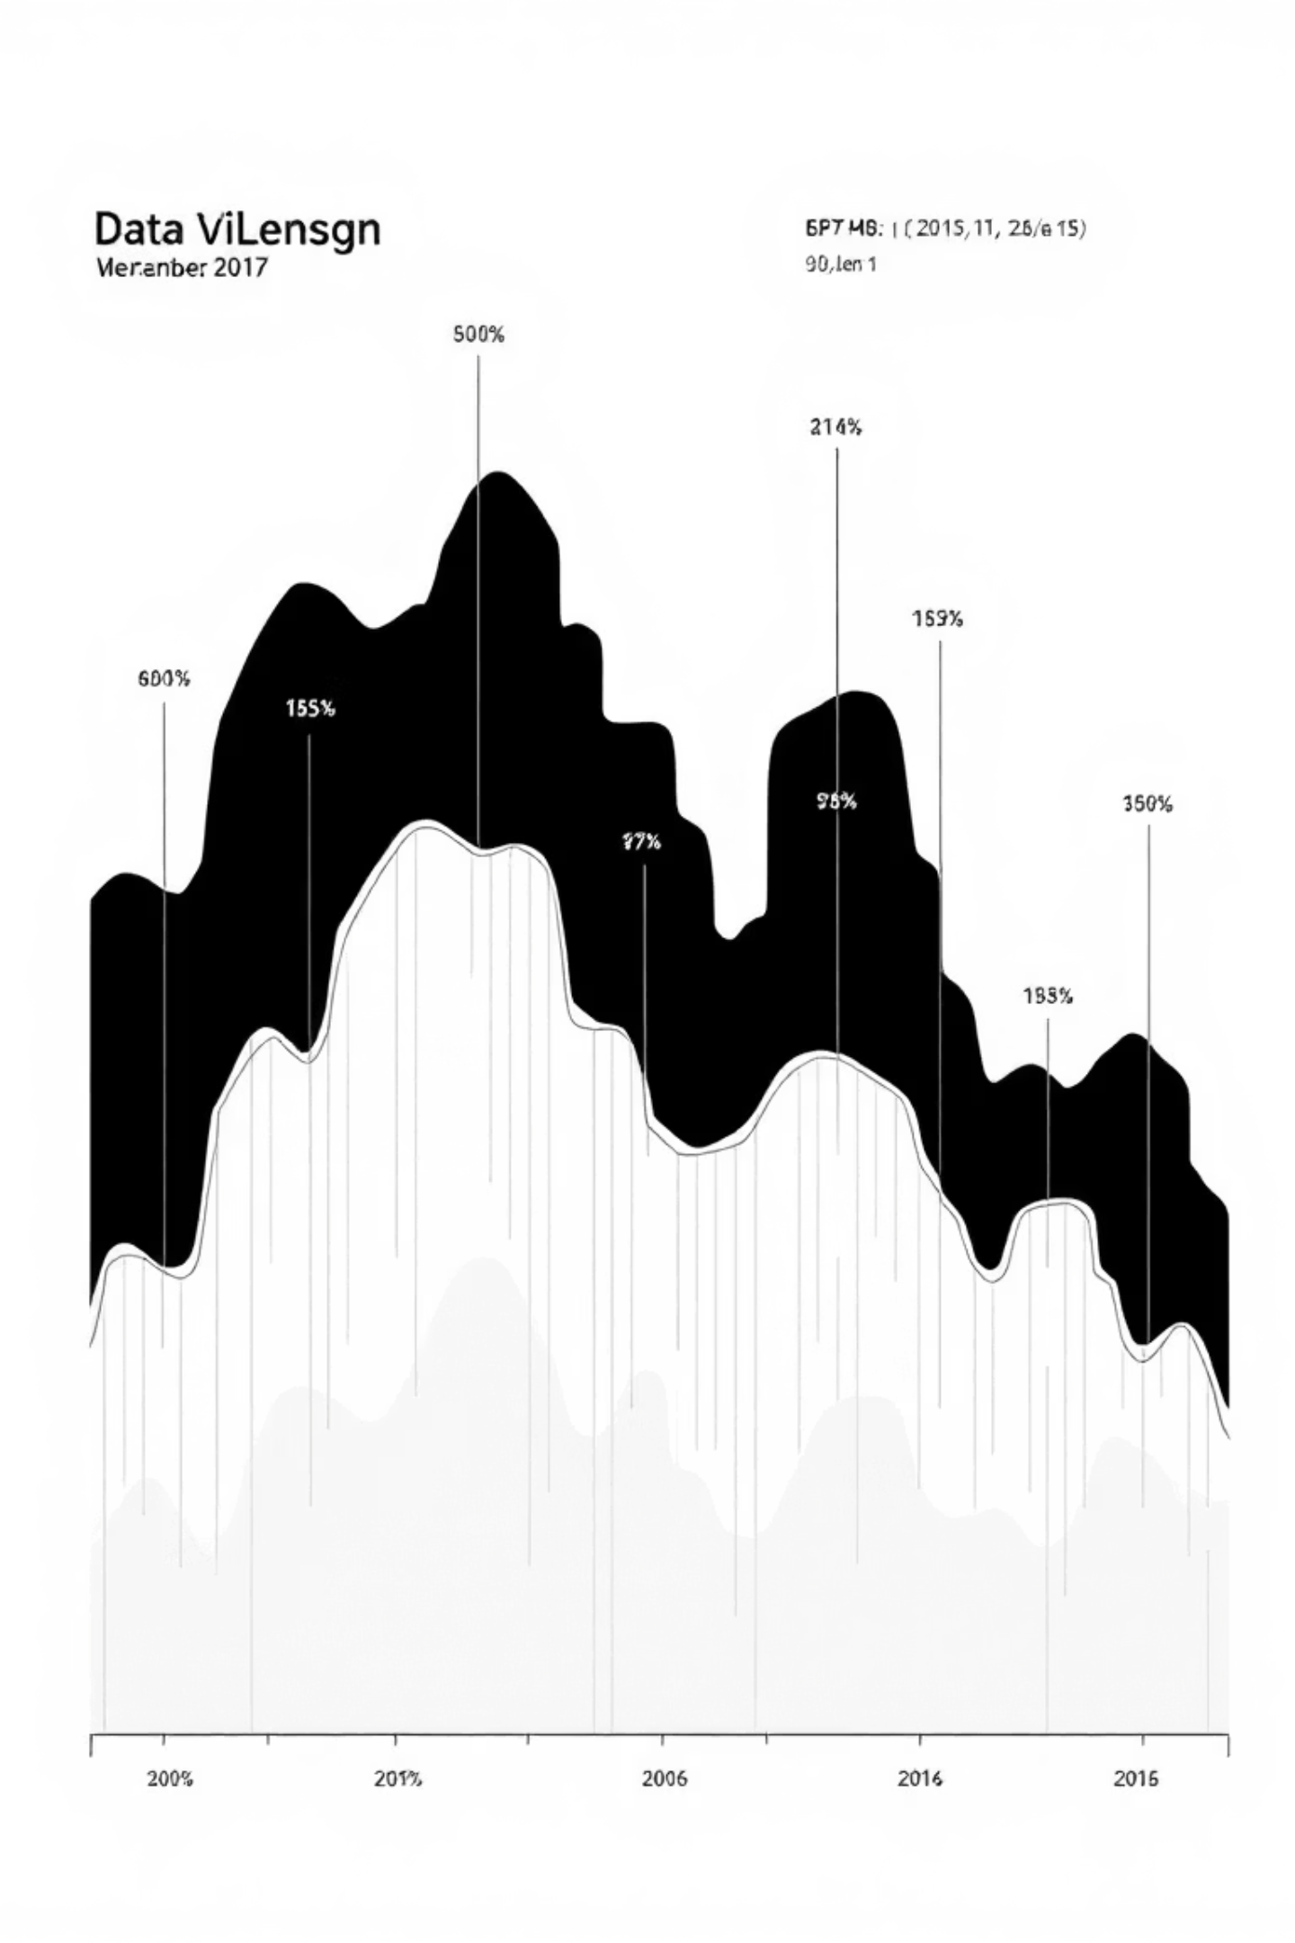
Experimentation: Summary Length Control
The system offers unprecedented flexibility through customizable summary lengths, enabling users to balance detail with brevity based on their specific needs.
30
60
100
Ultra-Concise
Balanced
Comprehensive
Perfect for quick overviews and rapid scanning
Optimal blend of brevity and essential detail
Thorough summaries preserving nuanced information
150
Detailed
Extended coverage for complex subject matter

Slide 8




Technical Architecture
Input Processing
AI Processing
Output Rendering
User submits text through web interface; content validated and preprocessed
Transformer model analyzes text structure and generates abstractive summary
Summary formatted and displayed with metadata in clean HTML report

Slide 9


Impact & Applications
Real-World Benefits
This tool addresses critical challenges in modern education, where information overload hampers effective learning.
Key Advantages
Reduces cognitive load during exam preparation
Enables faster content review and retention
Supports diverse learning styles and paces
Scales across disciplines and subject areas
Provides consistent, unbiased summarization

Slide 10

Thank You
AI Notes Summarizer
I appreciate your time and attention. I'm happy to answer any questions about the project architecture, implementation details, or future development plans.

